Slide 1


BE WELL Hospital Management System
Submitted by,
Anu Krishna, Ashish George, Francis, Vaisakh K M ,Vismay.

Slide 2
MODULES
FRONT-END : Francis Varghese and Vismay Vinod
BACK-END : Vaisakh K M, Anu Krishna, Ashish George

Slide 3
CONTENT
Introduction.
Objectives.
Existing system.
Disadvantages.
Proposed system.
System requirements.
Project journey.
Scope and Features.
Implementation.
Advantages and Disadvantages.
Future Implementation.

Slide 4
INTRODUCTION
What is Hospital Management System (HMS):
Hospital management system was introduced with the cause for helping hospitals speed up their processes.
A computer system that helps manage the information related to health care and aids in the job completion of health care providers effectively. They manage the data related to all departments of healthcare such as.
Blood bank.
Pharmacy.
Inpatient and outpatient.
Quick help
Covid portal.

Slide 5
OBJECTIVES
Design a system for better patient care .
Reduce hospital operating costs.
Completely integrated for any type of hospital from small to multi-chain hospitals.
Offers integrity and transparency between multiple departments.
Makes sure about the smooth functioning of a complicated hospital environment.

Slide 6




Existing System
Mocdoc
Attune
ITDose Infosystem
Suvarna HIS

Slide 7
DISADVANTAGES
Expensive.
Requires time to adapt fast.
Lack of features.
Lack of scalability.
Lack of quality logging system for end users.

Slide 8
PROPOSED SYSTEM
This Hospital Patient Management System is a self-contained system that manages activities of the hospital as clinical, blood bank, laboratory scheduling, material management and nursing, pharmaceutical and administrative matters.
A reliable app to store and retrieve data effectively in a hospital environment.

Slide 9
SYSTEM REQUIREMENTS
Database.
JDBC Driver.
Oracle SQL Express Edition.
Spring Framework.
JAVA Runtime Environment

Slide 10

REQUIREMENT ANALYSIS
Memory constraints
To run this software, the computer requires minimum 512MB Ram and more than 5GB hard storage .

Slide 11

PROJECT JOURNEY
Finalize features and tools
Topic Research
Research about features and tools
SRS Documentation
Product implementation
Product Delivery

Slide 12


SCOPE
Hospital Management System makes the working of a hospital smooth. It helps all the employees as well as the patients to be clear about all the procedures and happenings.
FEATURES
Reduces the workload.
Helps to keep the data in a secure way.
Data retrieval becomes easy.
Easy to modify and inform work details.

Slide 13
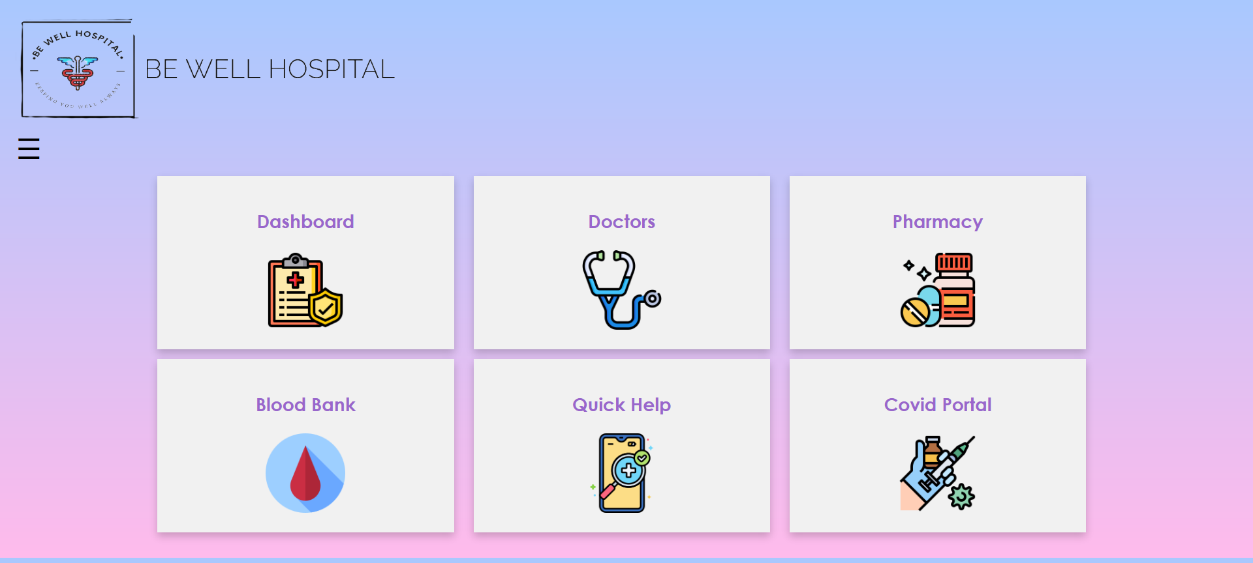
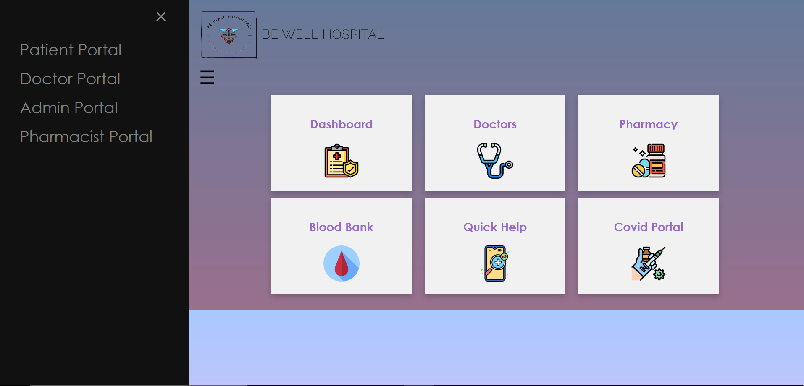
Home page

Slide 14
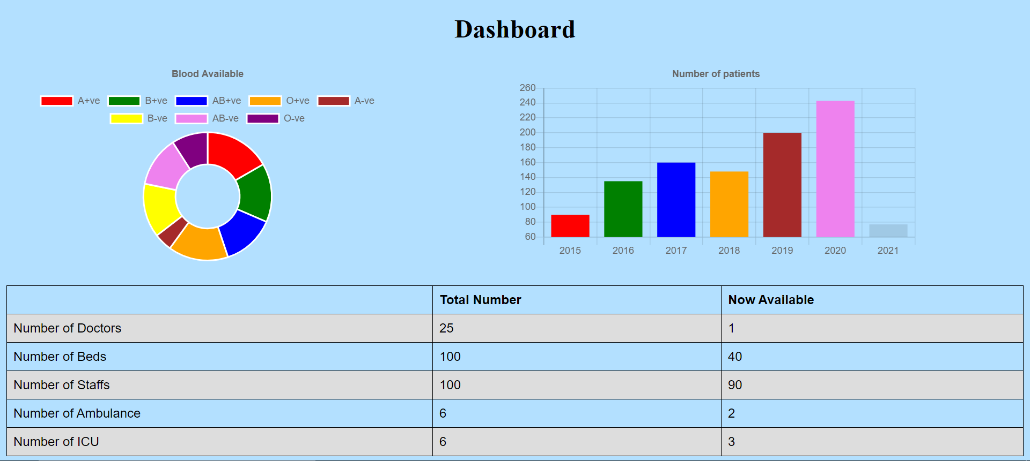
dashboard

Slide 15
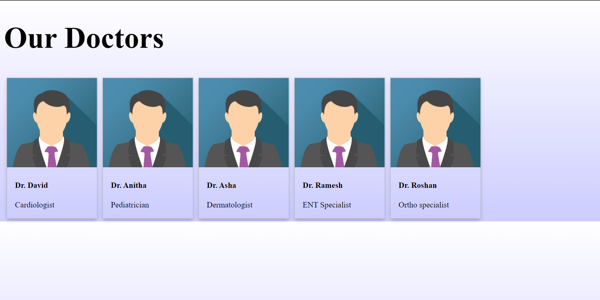
Our doctors

Slide 16
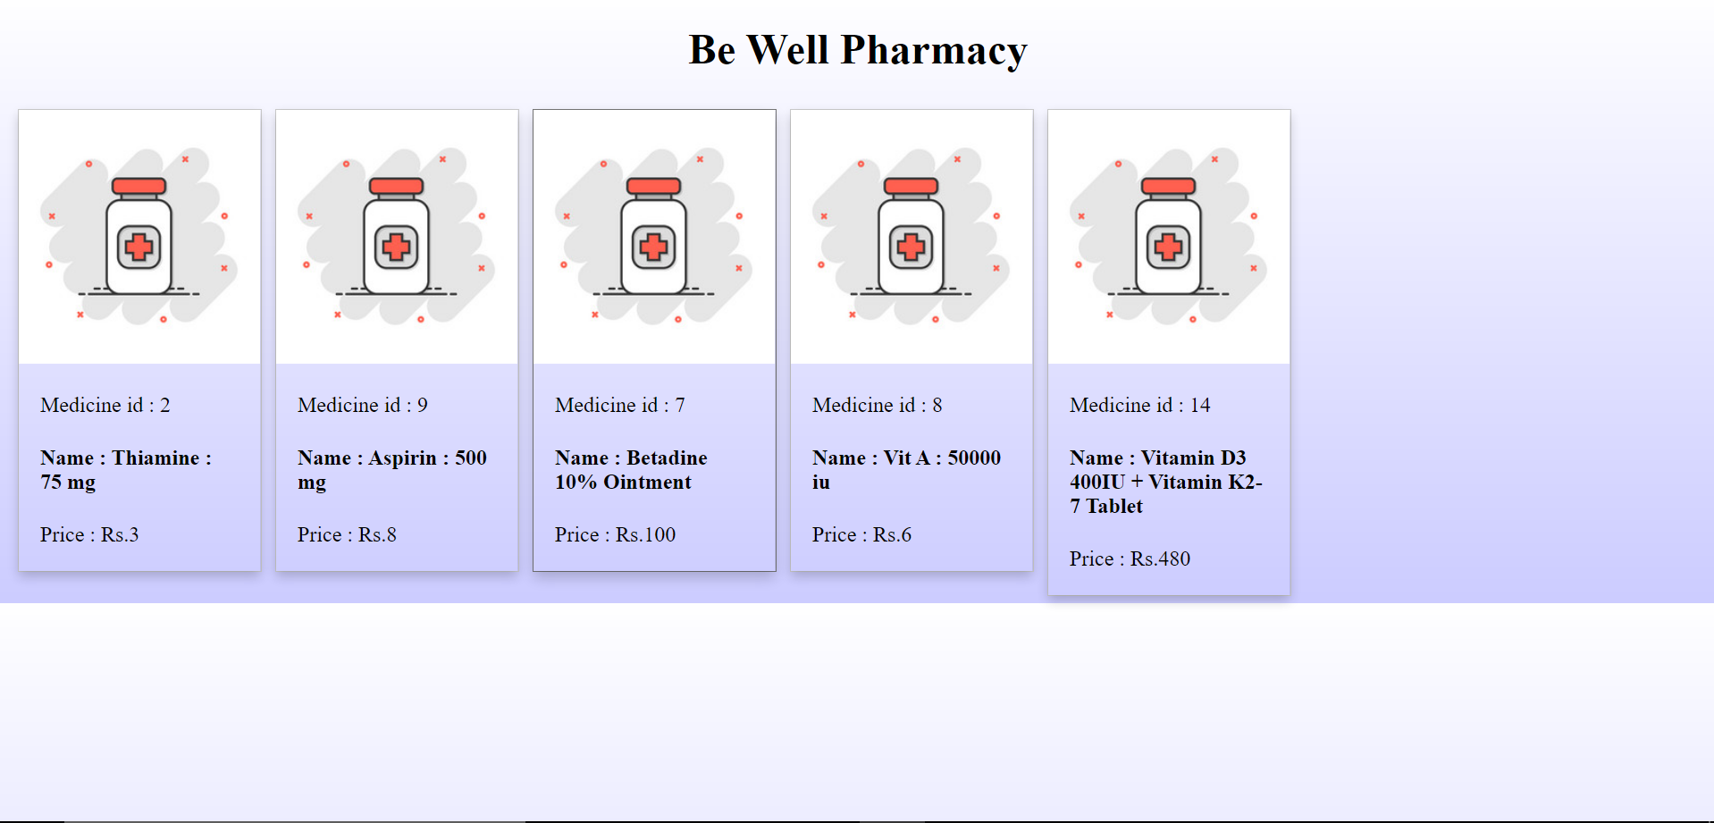
pharmacy

Slide 17
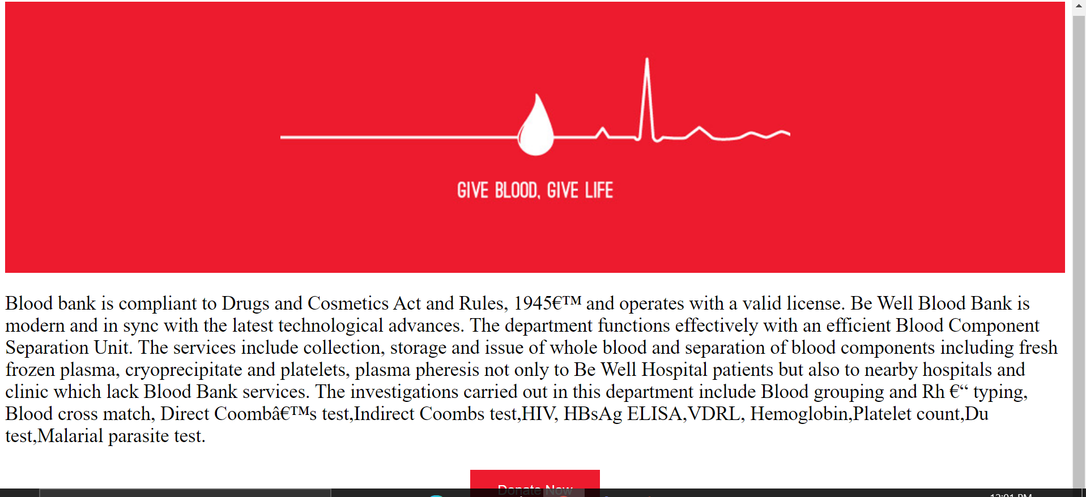
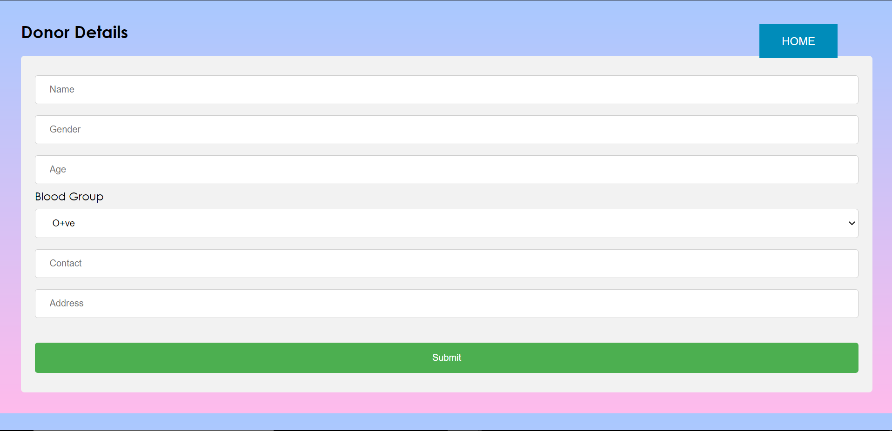
Blood bank

Slide 18
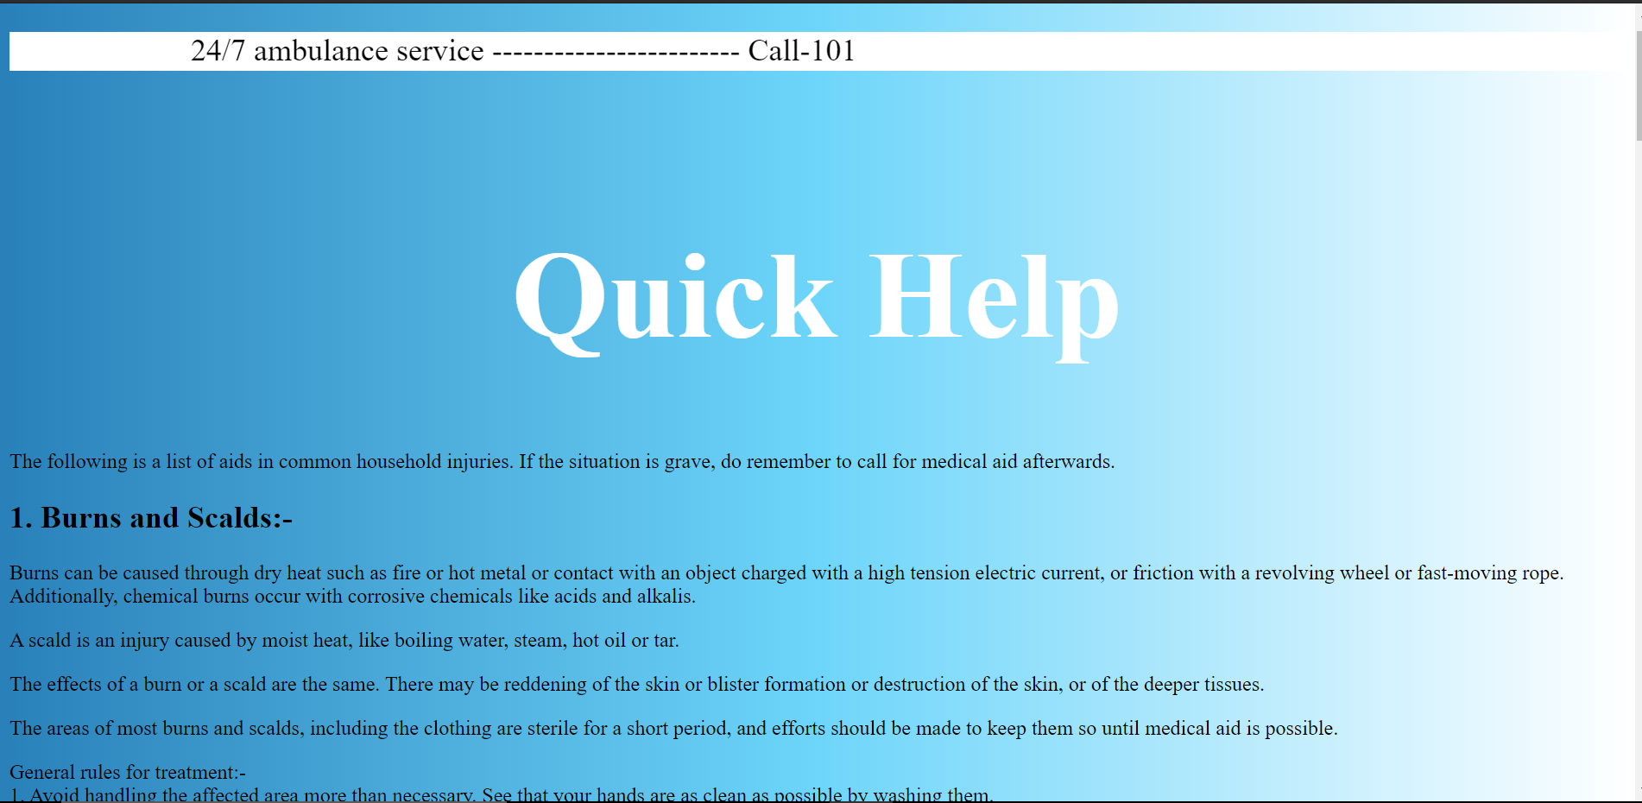
Quick help tile

Slide 19
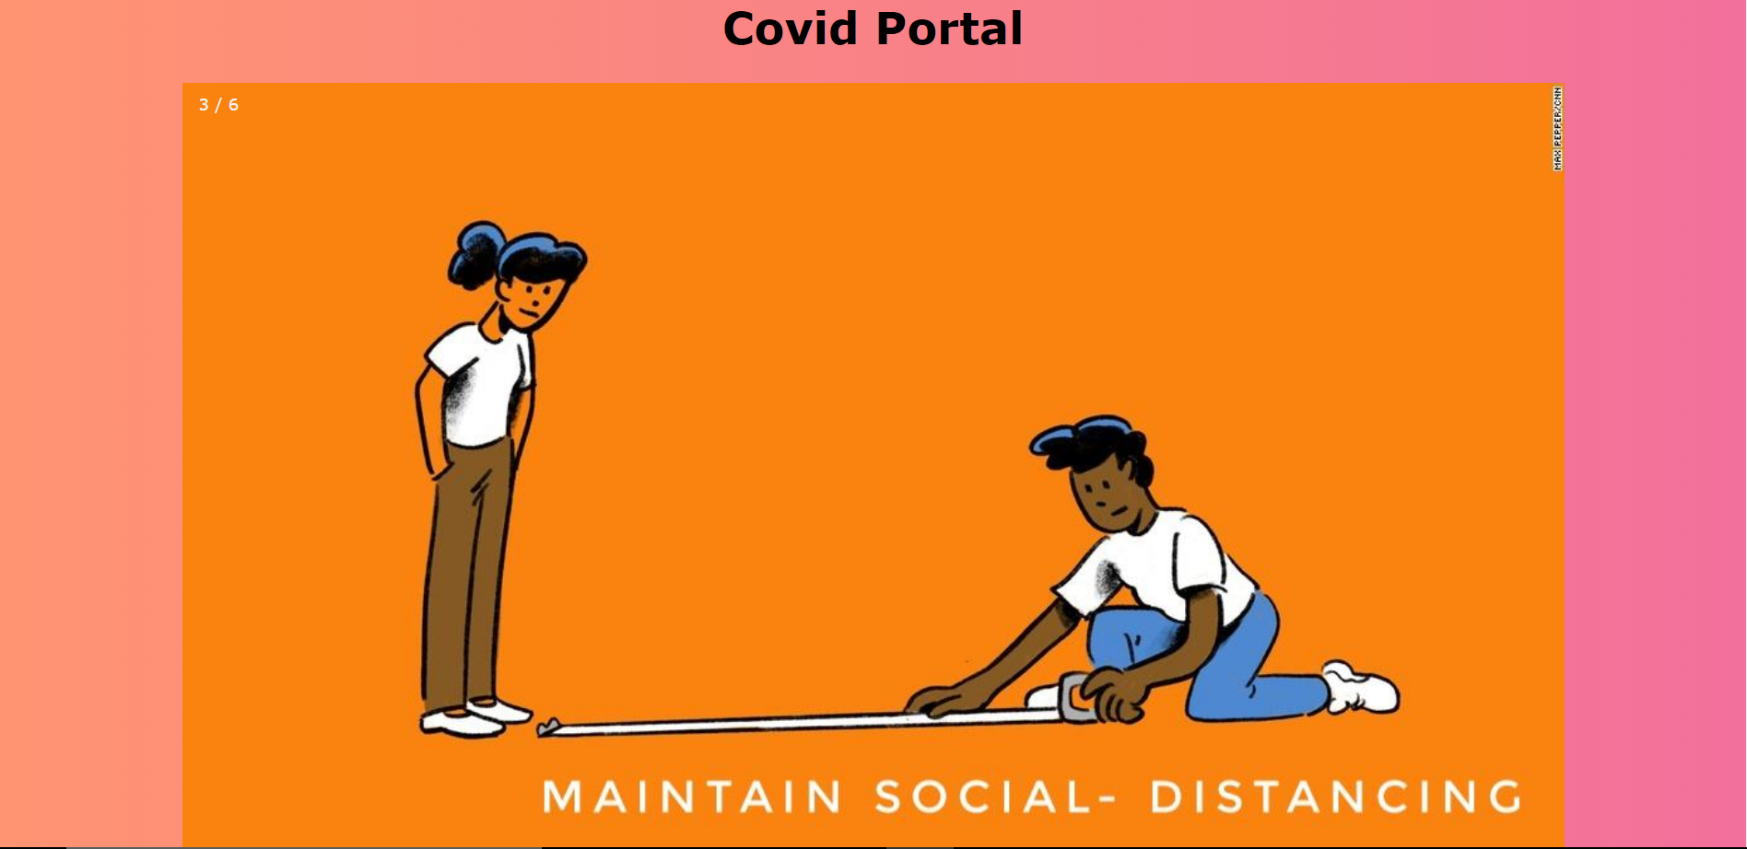
Covid portal

Slide 20
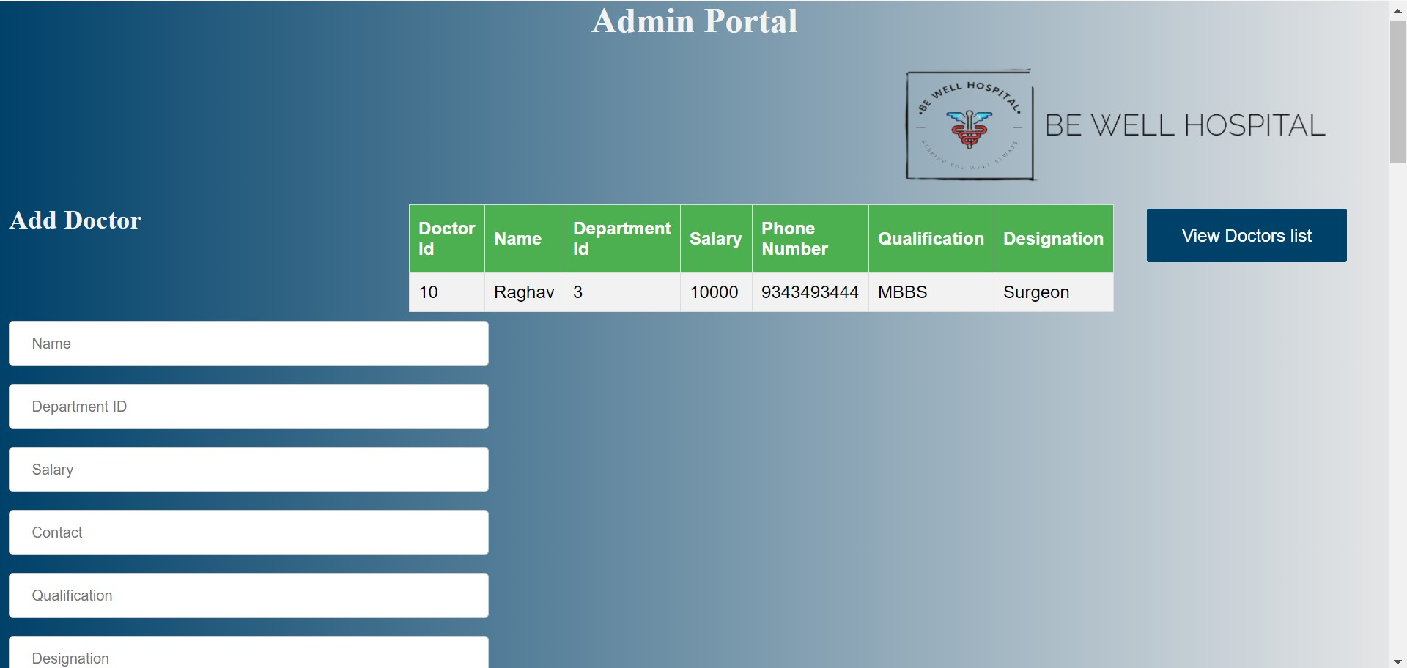
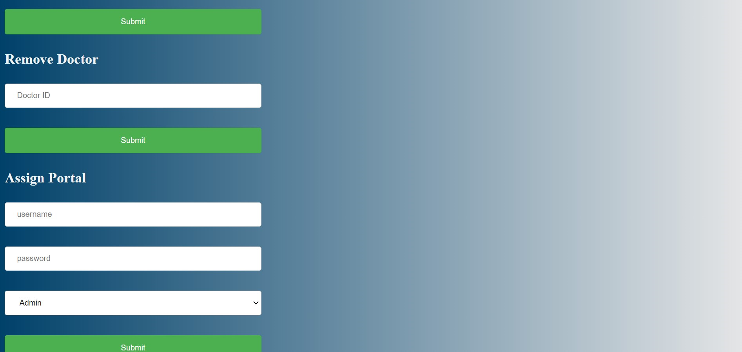
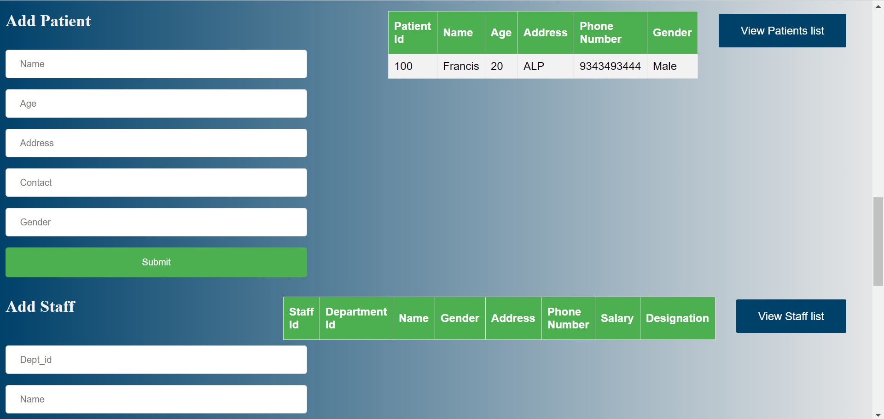
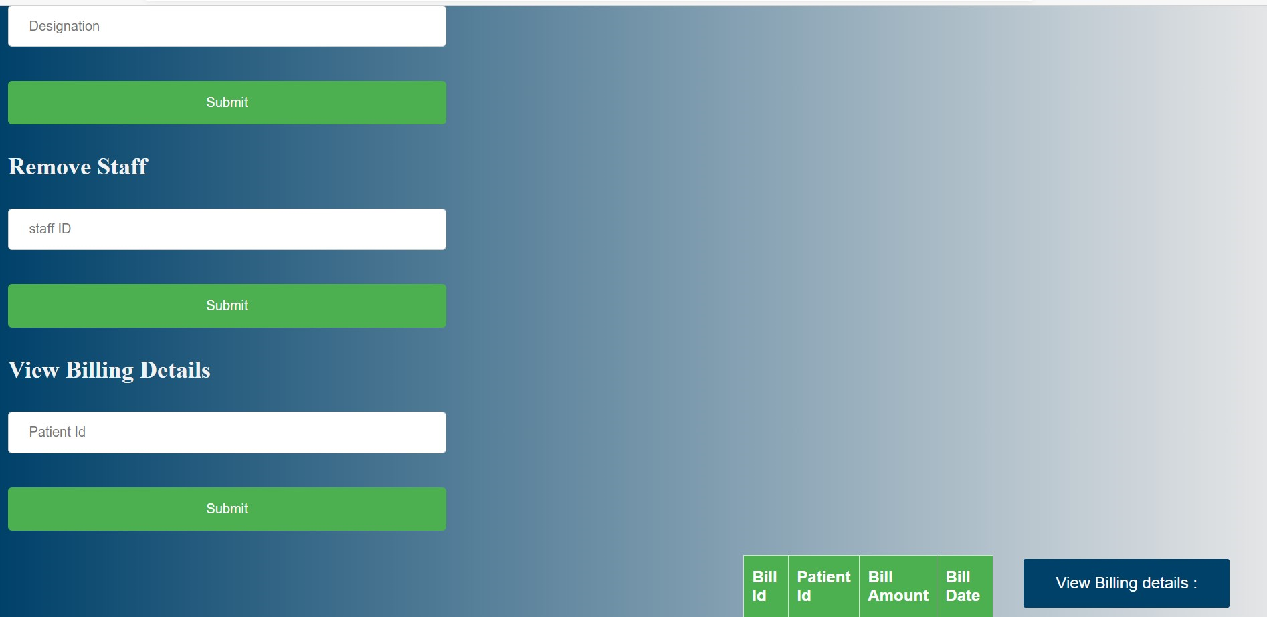
Admin portal

Slide 21
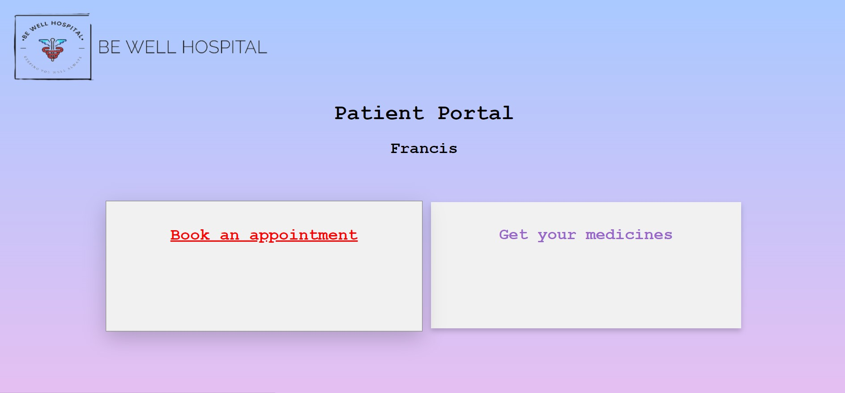
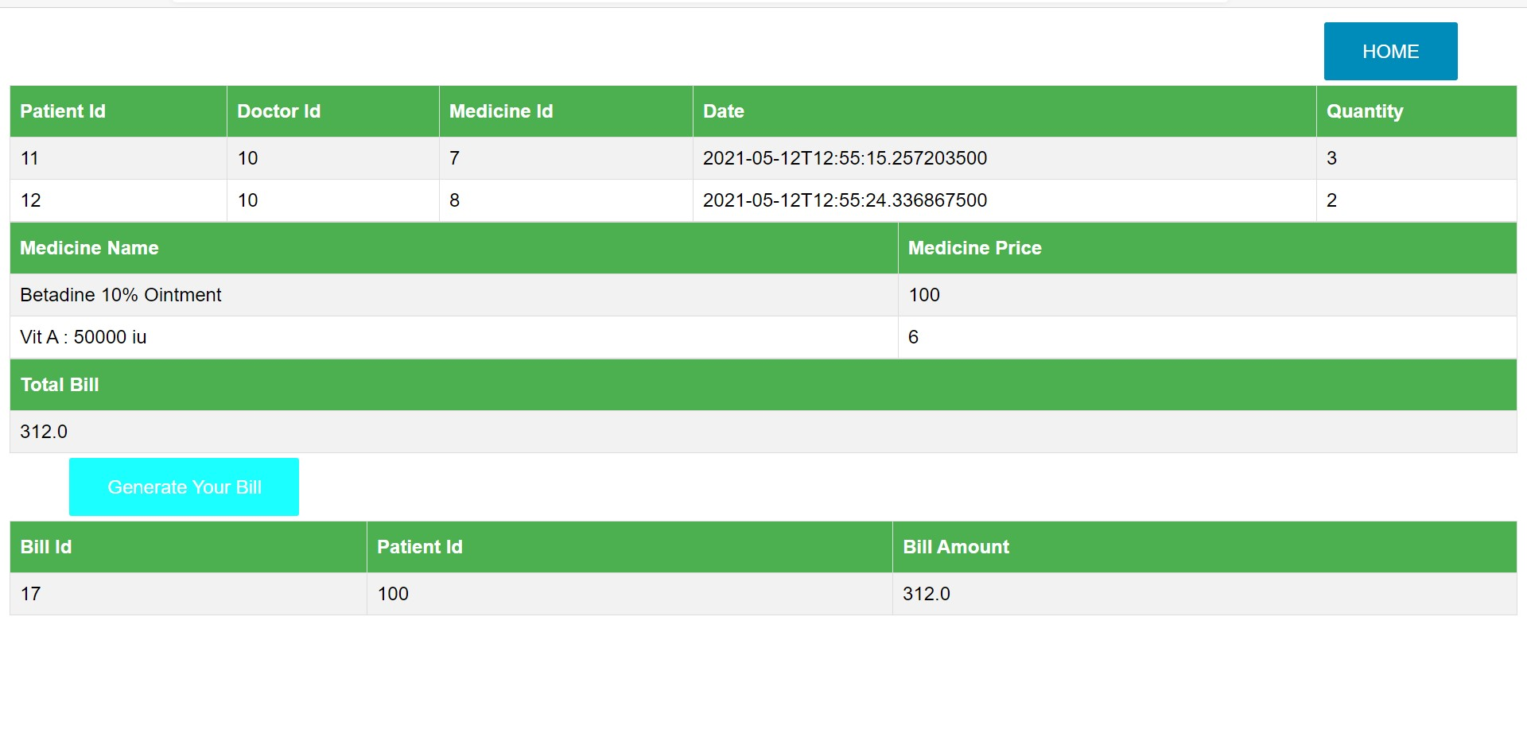
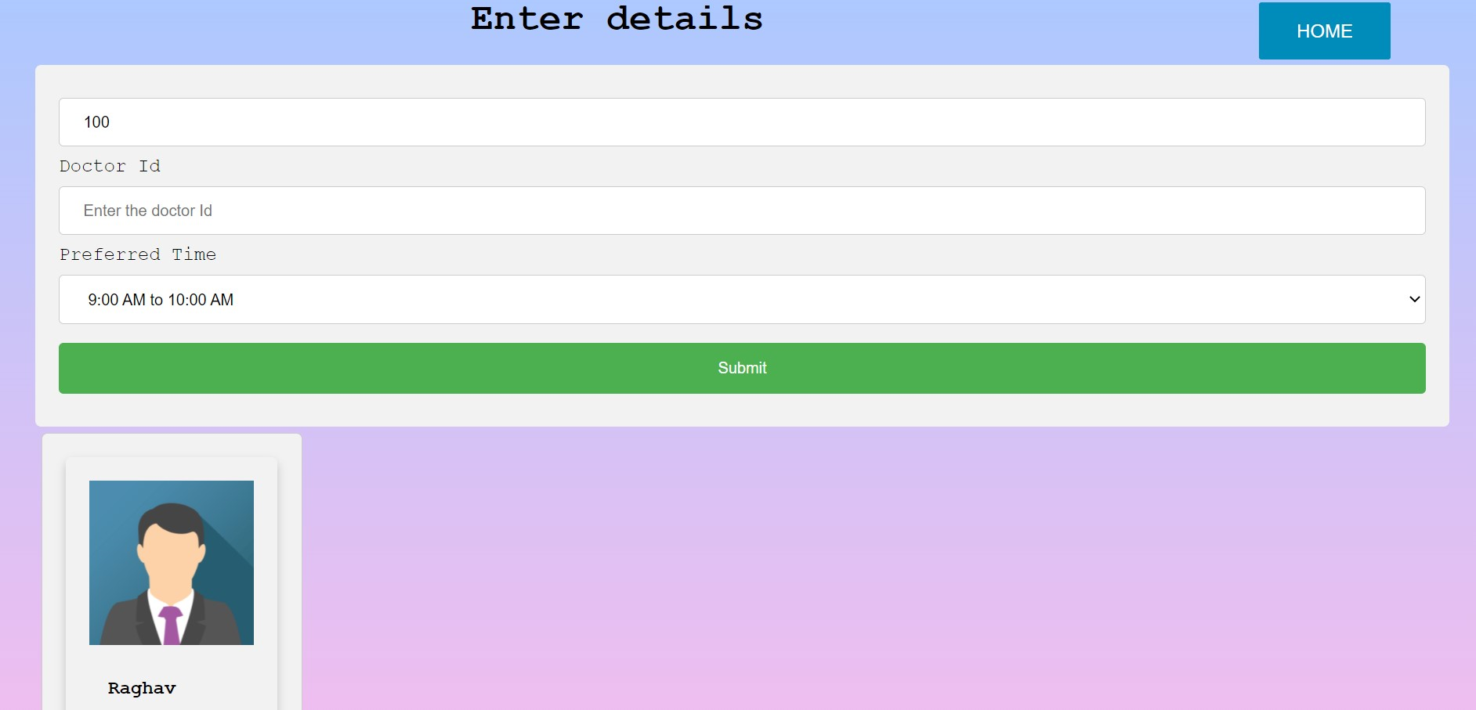
Patient portal

Slide 22
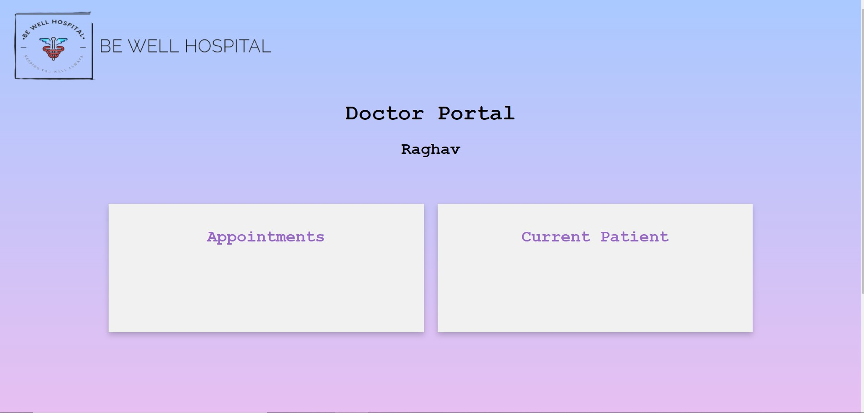
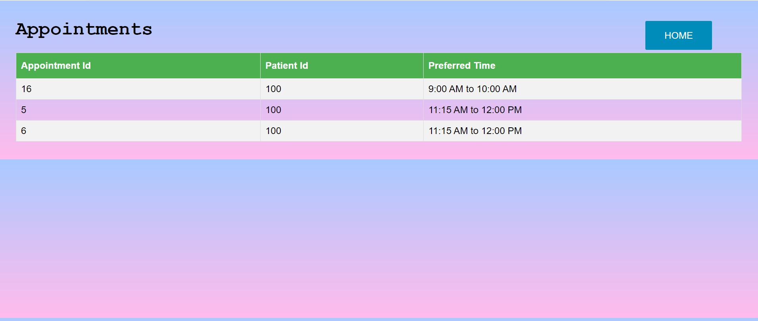
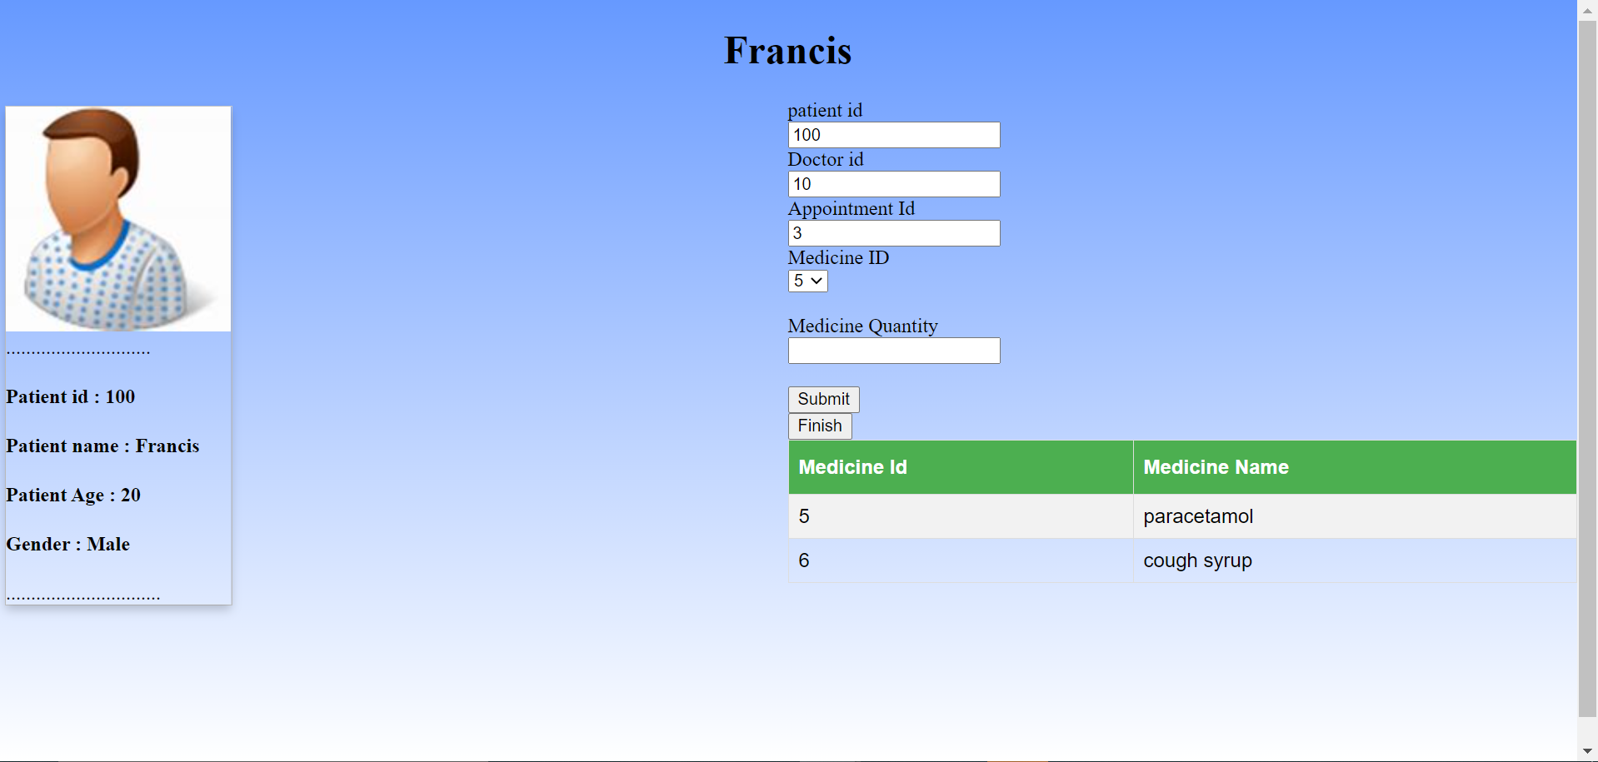
Doctor portal

Slide 23
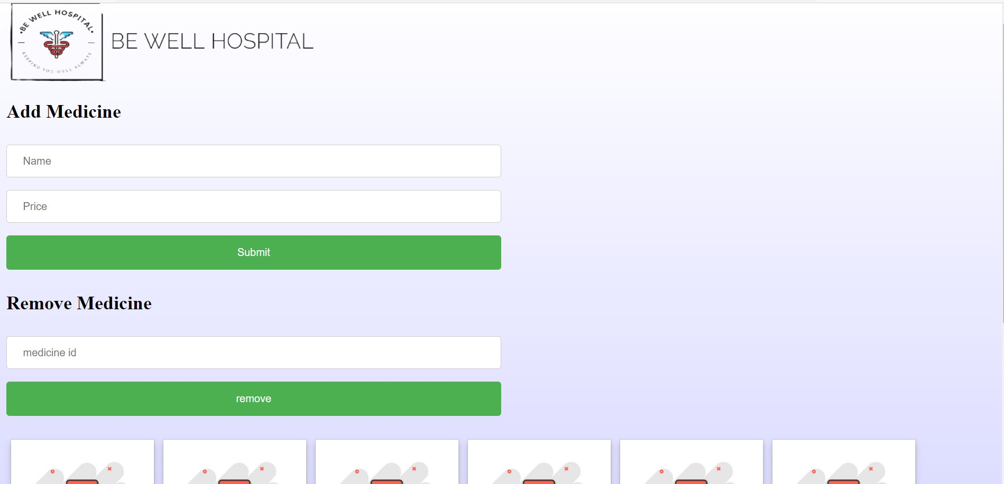
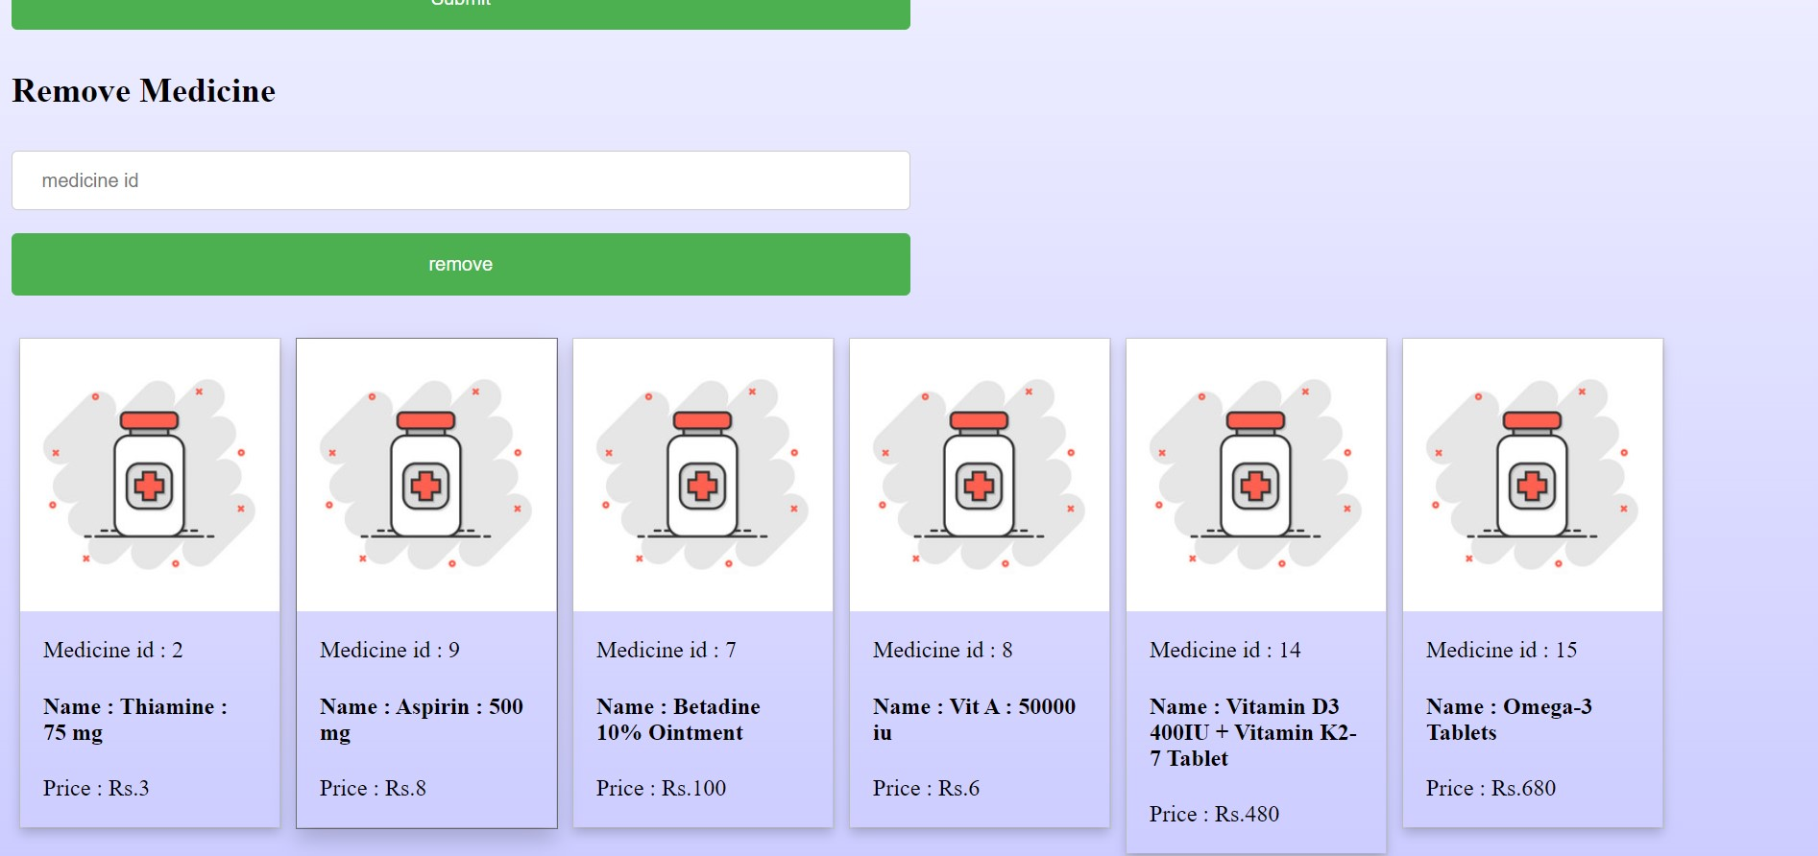
Pharmacy portal

Slide 24

ADVANTAGES
Processing Speed & Results.
Cost Effective.
Reduction in Errors.
Data security & Retrieving Ability.
Improved Patient Care.
Quality & Compliance.
DISADVANTAGES
Internet Usage.
Network Problems.
Lack of optimization.

Slide 25

FUTURE IMPLEMENTATIONs
Laboratory implementation.
Market strategy.
Improved features and processes.
Digital medical record.
Inventory management system.
Accounts management system.

Slide 26

Database
JAVA Runtime Environment.
JDBC
.

